Slide 1


BME
BY – CHANDANA MN
DIRECTED BY-PROF. DIVYA DEEPAK

Slide 2


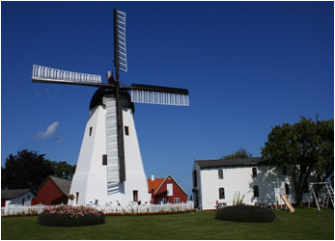
MINI PROJECT ON WINDMILLS

Slide 3
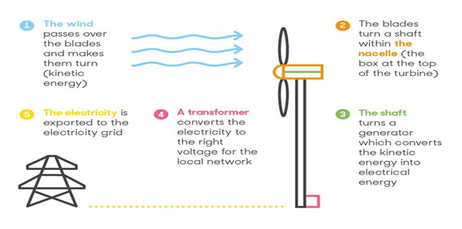

Slide 4
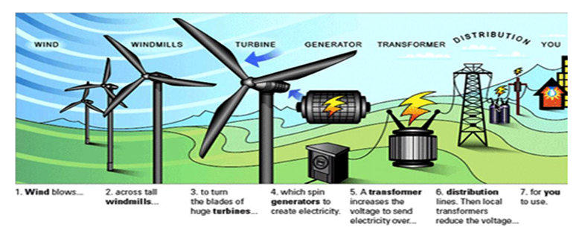

Slide 5
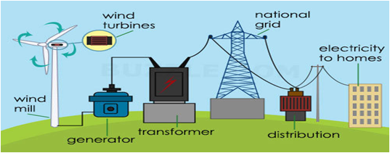

Slide 6
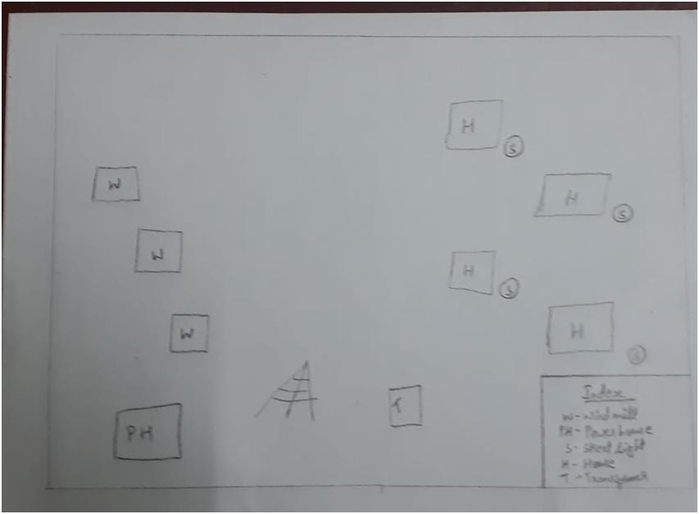
BLUEPRINT OF MY MINI PROJECT

Slide 7
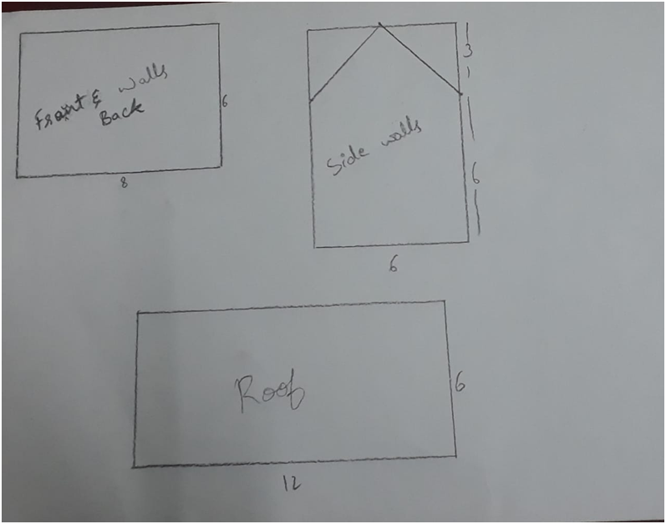
BLUEPRINT OF HOUSES

Slide 8
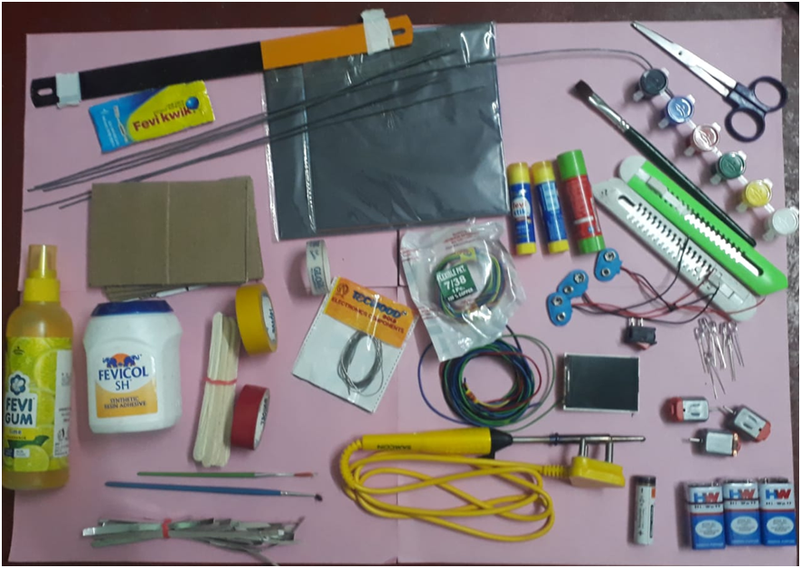
COMPONENTS USED

Slide 9
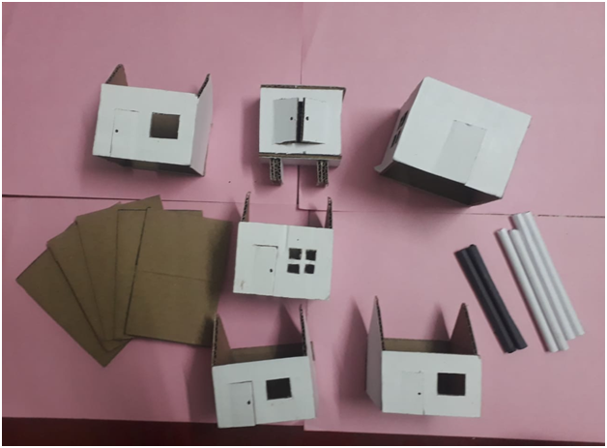

Slide 10
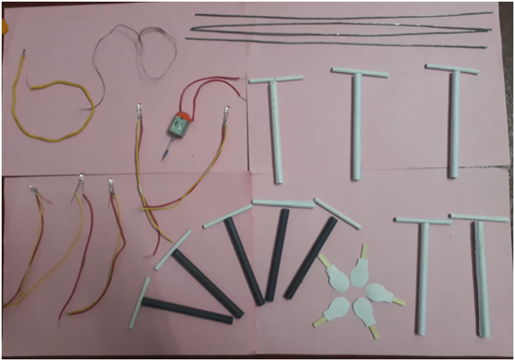

Slide 11
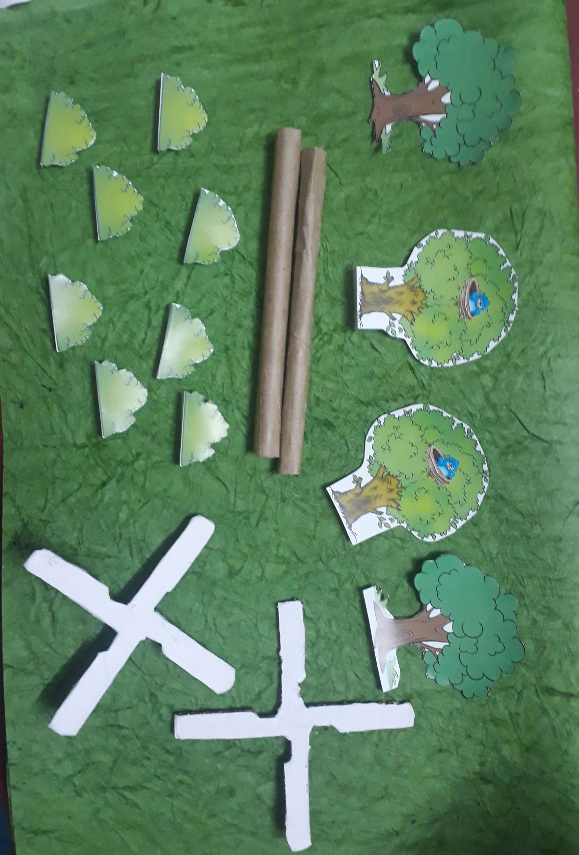

Slide 12
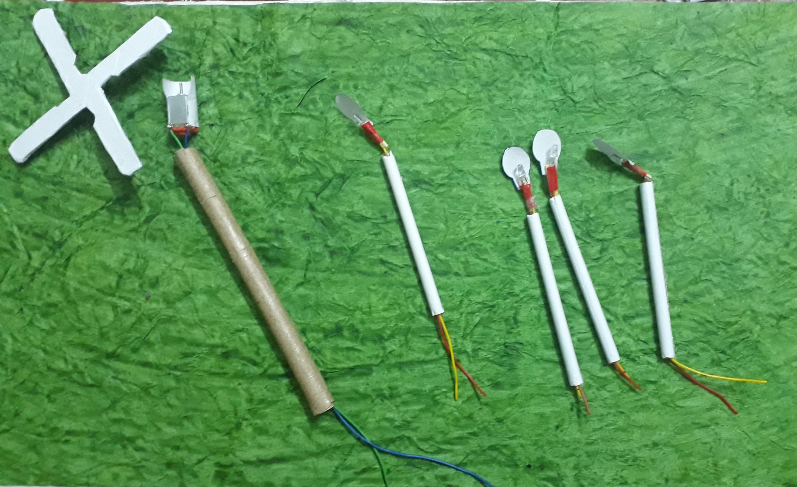

Slide 13
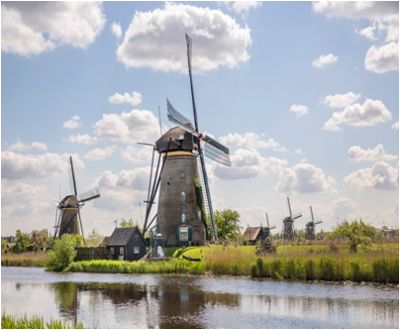
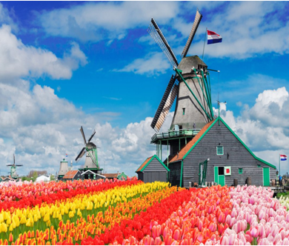
The Netherlands
The Netherlands is known for windmills, but it produces very little wind power-quarts

Slide 14
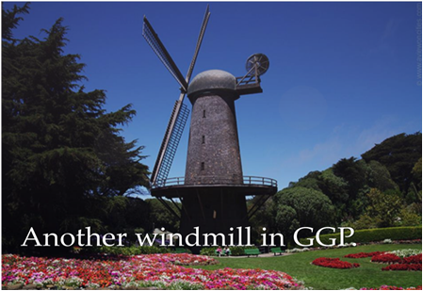
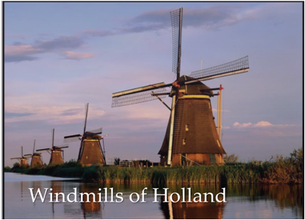
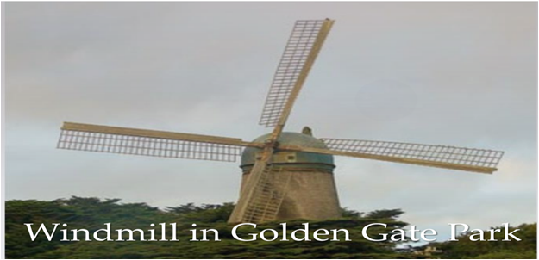
BEAUTIFUL PICTURES OF WINDMILLS

Slide 15
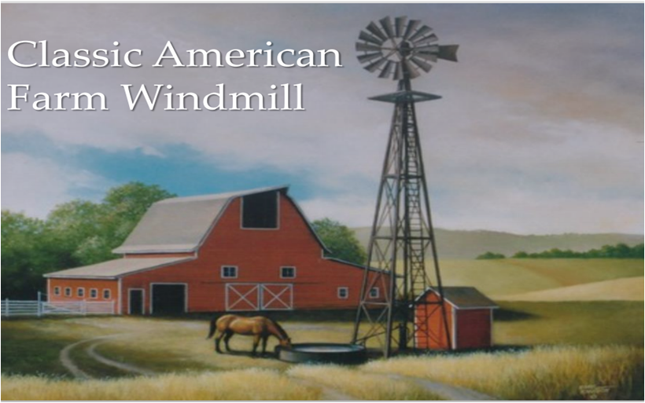

Slide 16


